Slide 1
Clarity, Care, Connection, and Credibility: Lessons from 15 Years of Online Teaching
Dr. Brenton Dickieson

Slide 2

Some of Our Questions
1
Context
2
Principles for Online Teaching
3
Design Tips
4
Communication
5
Other Tips for Connecting Online

Slide 3
Question Prompt
Raise your hand
Hand-raising poll:
How many of you have not taught much online before?
Notes:
First, before we begin: Prompt Question: How many of you have not taught much online before? (ask at the beginning, frame lesson like this)

Slide 4
Context

Slide 5
My Experience in Online Education
Am I like the industry?
1st Distance Class
1st Distance Audio
Online Transformation
COVID-19
Reading materials from a binder supplemented with books; marked by an invisible teacher
Audio tapes (then CD/DVD), reading materials from a binder supplemented with books; marked by an invisible marker
Using the same pre-recorded model, I became an active online instructor, not invisible
After years of neglect and abuse, schools suddenly are scrambling to teach online
1999
2005
2016
1995
2001
2011
2020
1st Online Class
I Begin Teaching Online
Signum University
Reading materials online supplemented with books; online forum; marked by an invisible teacher who engaged in forums
CD/MP3 lectures, online forums, invisible marker and forum moderator
Combining various methods of live online in-class experience moderated to global student needs

Slide 6
Question Prompt
Think about this question
Chat Box Question:
What will you miss most about not having students right at your side?
Notes:
Prompt Question: What will you miss most about not having students right at your side? (ask at the beginning, frame lesson like this)

Slide 7
Principles for Online Teaching

Slide 8

Principles of Online Teaching
The core principles of teaching remain the same
How do we get students to engage?
What is the adventure of learning?
What is the relationships between “data” and learning
Where are we inviting students into?
Clarity
Care
Connection
Credibility
Notes:
Principles for Online Teaching
The core principles of teaching remain the same (my philosophy: classroom as encounter).
The technology space is different, however, than a classroom space. I won’t be talking as much about the technology but trying to model it, so I can take questions at the end.
Synchronous vs. Asynchronous Teaching
Buechner, Now and Then: A Memoir of Vocation, TEACHER, PASTOR, WRITER

Slide 9
Synchronous vs. Asynchronous Teaching
What’s the critical difference?
Synchronous
Teaching that happens in-real time with students
01
02
Asynchronous
Teaching that is captured to be engaged with when the student is ready (or at the right time in term)

Slide 10
3 Types of Synchronous Teaching
Here is a segment of a slide I forgot to design—students will chuckle, and it’s okay
 | 1
 | Lecture
 |  | Materials
 |  | Goals
 |  | AV
 | Dissemination
 | 2
 | Discussion
 |  | Materials
 |  | Goals
 |  | AV
 | Discussion
 | 3
 | Seminar
 |  | Materials
 |  | Goals
 |  | AV
 | Discovery
Notes:
Lecture mode with questions
Guided discussion mode
Seminar mode

Slide 11
3 Sizes of Class Discussion
What dynamics are at play when we have different class sizes online?
 | 15+ Students
 | Large
 |  | Materials
 |  | Goals
 |  | AV
 | Lecture Hall
 | 5-19 Students
 | Medium
 |  | Materials
 |  | Goals
 |  | AV
 | Roundtable
 | 1-6 Students
 | Small
 |  | Materials
 |  | Goals
 |  | AV
 | Office Session
Notes:
Small:
Medium:
Large:

Slide 12
Design Tips

Slide 13
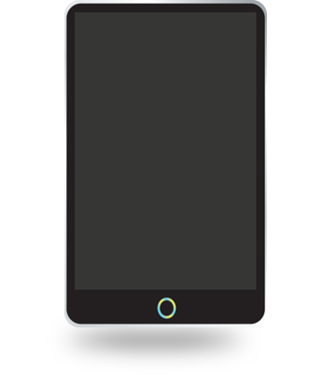
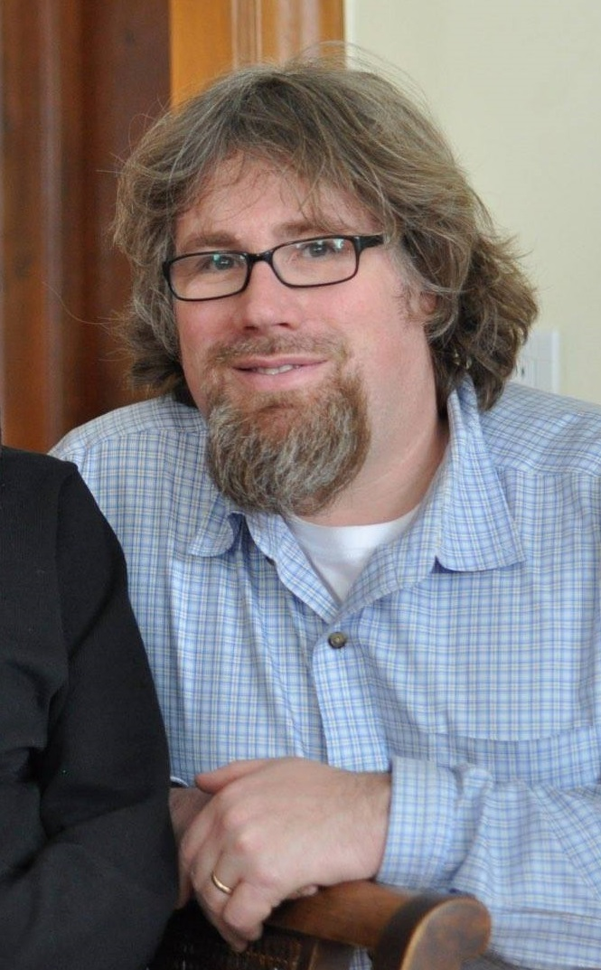
Design Tips
There are multiple ways to think about design
Know Why You are Designing
Use Visuals Naturally
Use Pre-built Design Tools
Design Your Work Space
Define Design Priorities
Notes:
Go from bottom to top
What is your space like? (coffee/water, mic, earbuds, screens, socks/slippers/shoes, chair, where’s your phone?, books/notes ready, fans, cool/heat before, background noise, etc.)
→ Go to pic
Ahead of visual design:
Sound is more important than visual design (Blue Yeti, Blue Snowball)
Lighting
Camera (close for Asynchronous, further for Synchronous)Use pre-built design tools (Prezi, Powerpoint templates, etc.)
Visuals
Don’t be afraid to use other great youtube and other resources, but watch them carefully first
Try in-video play before you do it live
Design Well (core basic design; delegate design), but don’t worry about it
I use my design:
To attract students--or share a joke with them, if it is terrible (i.e., fun)
To allow visual metaphors to focus my key points
To provide both teaching and review materials
To shape the way I communicate

Slide 14
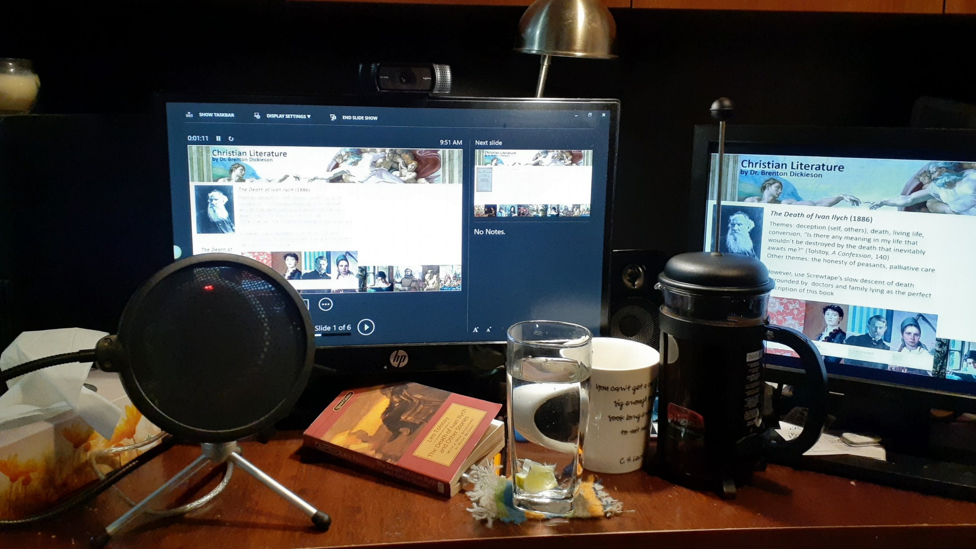

Slide 15
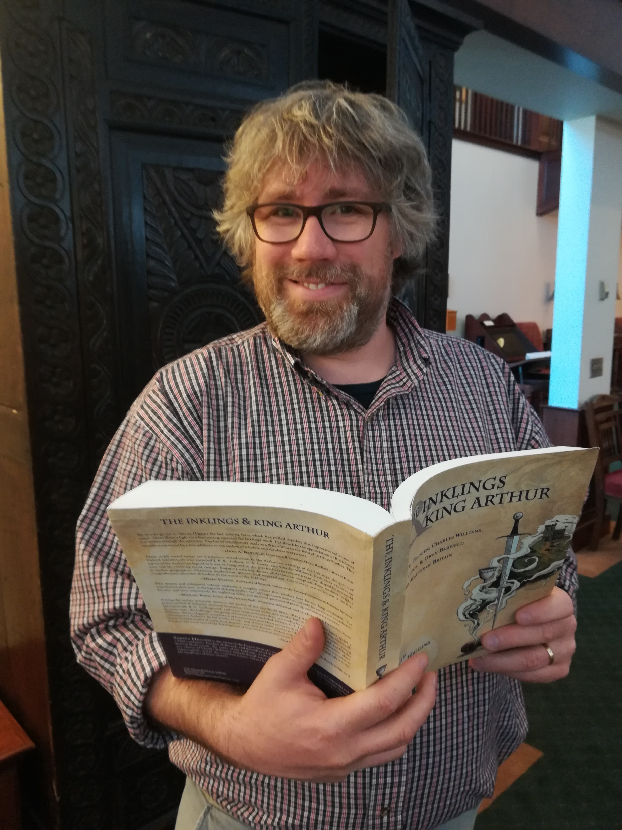
Design Tips
There are multiple ways to think about design
Know Why You are Designing
Use Visuals Naturally
Use Pre-built Design Tools
Design Your Work Space
Define Design Priorities
Notes:
Go from bottom to top
What is your space like? (coffee/water, mic, earbuds, screens, socks/slippers/shoes, chair, where’s your phone?, books/notes ready, fans, cool/heat before, background noise, etc.)
→ Go to pic
Ahead of visual design:
Sound is more important than visual design (Blue Yeti, Blue Snowball)
Lighting
Camera (close for Asynchronous, further for Synchronous)Use pre-built design tools (Prezi, Powerpoint templates, etc.)
Visuals
Don’t be afraid to use other great youtube and other resources, but watch them carefully first
Try in-video play before you do it live
Design Well (core basic design; delegate design), but don’t worry about it
I use my design:
To attract students--or share a joke with them, if it is terrible (i.e., fun)
To allow visual metaphors to focus my key points
To provide both teaching and review materials
To shape the way I communicate

Slide 16
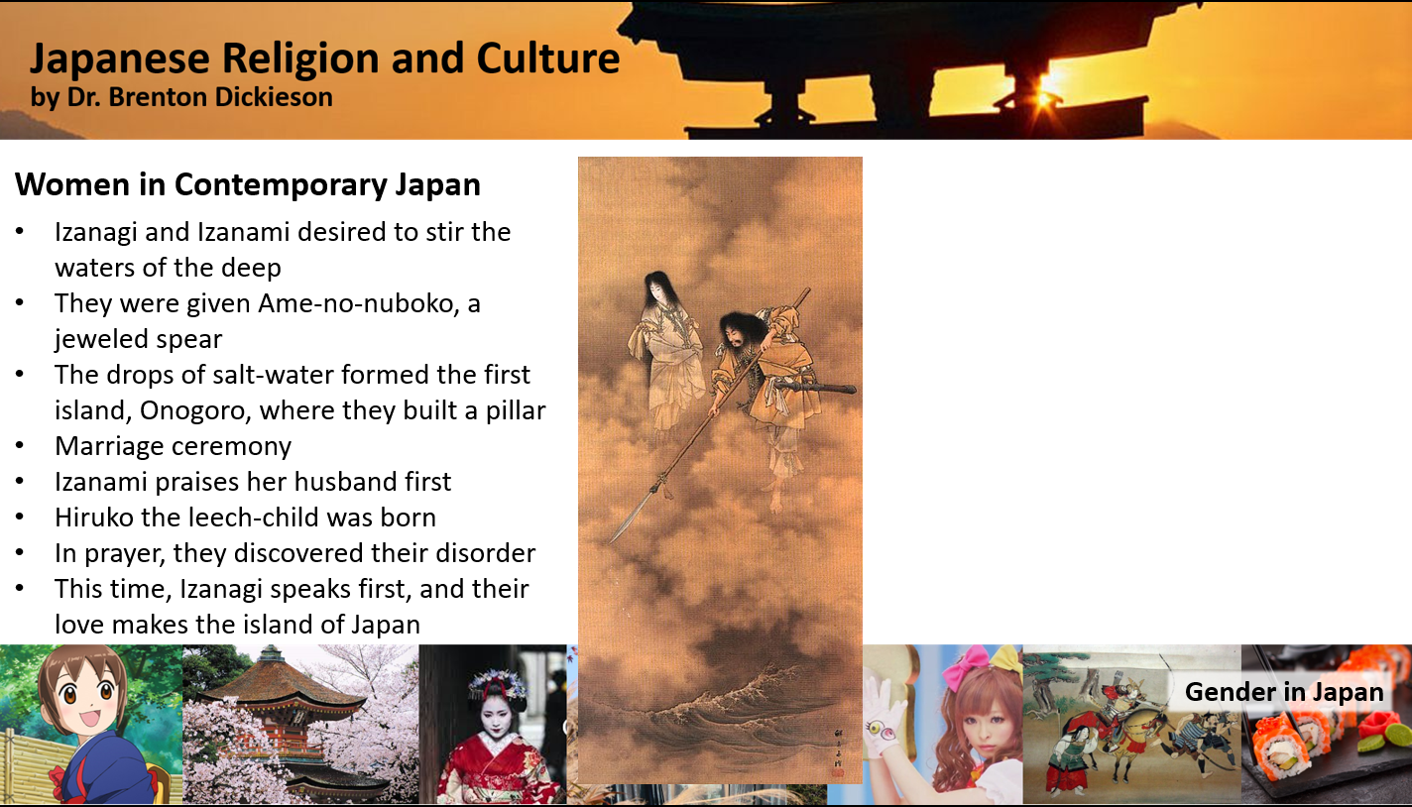

Slide 17
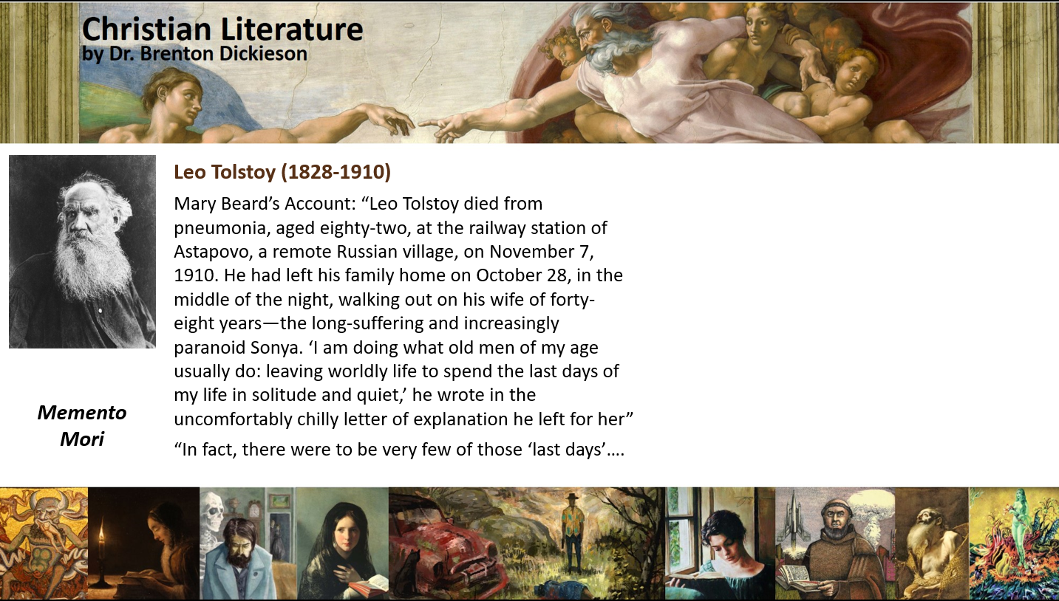

Slide 18


Slide 19





Slide 20

Design Tips
There are multiple ways to think about design
Know Why You are Designing
Use Visuals Naturally
Use Pre-built Design Tools
Design Your Work Space
Define Design Priorities
Notes:
Go from bottom to top
What is your space like? (coffee/water, mic, earbuds, screens, socks/slippers/shoes, chair, where’s your phone?, books/notes ready, fans, cool/heat before, background noise, etc.)
→ Go to pic
Ahead of visual design:
Sound is more important than visual design (Blue Yeti, Blue Snowball)
Lighting
Camera (close for Asynchronous, further for Synchronous)Use pre-built design tools (Prezi, Powerpoint templates, etc.)
Visuals
Don’t be afraid to use other great youtube and other resources, but watch them carefully first
Try in-video play before you do it live
Design Well (core basic design; delegate design), but don’t worry about it
I use my design:
To attract students--or share a joke with them, if it is terrible (i.e., fun)
To allow visual metaphors to focus my key points
To provide both teaching and review materials
To shape the way I communicate

Slide 21
Communication

Slide 22

Communication
Teaching is communication
Be Clear
Be Concise
Coax Cooperation
Receive Comments
Communicate Care
Over-Communicate
In all the lessons that I have learned in 15 years of online teaching, this is the absolute most important one.
It’s true that this doesn’t work as a long-term solution, but in online education for a “skim” generation, try your best to connect.
Notes:
Teaching is communicating, which begins before the class session and continues until after. Some Tips:
Communicate Care
Give Clear Guidelines
Excel in Simplicity
Read Full Questions/Comments in Discussion
Coax Cooperation
Overcommunicate

Slide 23
Other Simple Tips

Slide 24
Question Prompt
Let’s talk about this in a moment
Share Your Voice question:
What online teaching tips have you discovered?

Slide 25
Other Tips For Connecting Online
Teach to the Green Dot
Eye contact is key. Teaching notes?
What do students see?
What’s on your Screen? AV
Prompt Interactive Sections
Names, hand-raising, polls, QFT
Wear Pants Anyway
Dress Professionally. You might get caught.
Notes:
Teach to the Green Dot (eye contact; where are your teaching notes?)
Be careful whats on your screen when you share it!
Audio, visual: Have students share their video (and of course the teacher must share)
Prompt Interactive Sessions (guide students, leading questions, wait for the pauses)I make myself available before and after the session
Use Names
Learn to use the hand-raising feature
Explore other features, like polls, surveys, visual cues
QFT
Wear Pants Anyway (and dress the right way)

Slide 26
Some Other Critical Questions
Some things don’t need a subtitle
What about marginal students?
How do you get students to talk to one another?
What can you capture to reuse?
What kind of flexibility can you offer?
What ways can students respond to the learning experience?
What can you learn?
What are students feeling?
Notes:
While some students will no doubt shine in new ways in a digital learning environment, often marginalized kids still remain marginalized. How do we reach them? International, second-language, limited internet….
How do you get students to talk to one another? (bring voices in early, prompt question or mic check)
We don’t know how long this will last, so once you have created a baseline learning program, how do you start introducing core learning steps within your curriculum?
What can you capture to reuse in the future?
What kind of flexibility can you offer?
What ways can students respond to learning experience?
What are students feeling during these days?

Slide 27
Question Prompt
Let’s talk about this in a moment
Share Your Voice question:
What online teaching tips have you discovered?

Slide 28
Thank you
I don’t disappear—feel free to ask me questions

Slide 29
Clarity, Care, Connection, and Credibility: Lessons from 15 Years of Online Teaching
Dr. Brenton Dickieson

